Slide 1


NREGA Data Analysis
By Akshay Sunil Kumar,
SE AIML, SIES GST NERUL

Slide 2
What is NREGA or MGNREGA?
NREGA stands for Mahatma Gandhi National Rural Employment Guarantee Act.
It is a law enacted by the Indian government in 2005 that guarantees 100 days of wage employment in a year to any rural household whose adult members volunteer to do unskilled manual work.
MGNREGA is one of the world's largest poverty alleviation programs and has been credited with playing a significant role in reducing rural poverty in India.

Slide 3

The main objectives of MGNREGA are:
To provide a legal guarantee for 100 days of wage employment in a year to rural households whose adult members volunteer to do unskilled manual work.
To improve the purchasing power of rural poor.
To create rural infrastructure assets.
To promote equity and social justice.
To strengthen the Panchayati Raj institutions.

Slide 4
Let us analyse the data provided to find answers to certain questions such as :
How effective is NREGA in providing employment opportunities to rural households?
Are there regional disparities in the implementation and outcomes of the scheme?
What is the utilization of the allocated budget, and how does it correlate with employment generation?
What are the key factors contributing to the completion of NREGA works, and are there any roadblocks to its success?
Can data-driven insights guide policymakers and administrators in optimizing the scheme's impact?

Slide 5
How effective is NREGA in providing employment opportunities to rural households?
Total Number of Job cards issued is 156 M .
Total Number of Active job card is 97 M which means many people have benefited from this scheme but comparing with the number of job cards issued , this could get much better.
428K Households completed 100 days of wage employment
Sum of Average days of employment provided per household was 23K

Slide 6
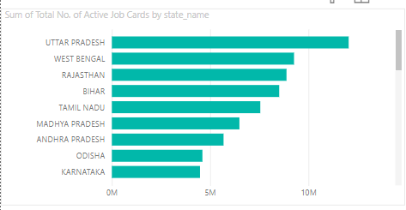
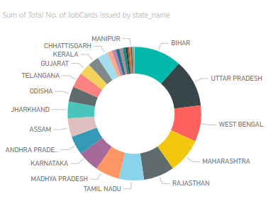
Are there regional disparities in the implementation and outcomes of the scheme?
Certain states like Bihar , Maharashtra are ahead in the ranking of states in terms of Number of job cards issued
But these same states lag behind in terms of the number of active job cards
Active job cards indicate households that are currently benefiting from wage employment, as opposed to merely being registered.
Insufficient project planning and execution or lack of engagement could be the reason

Slide 7
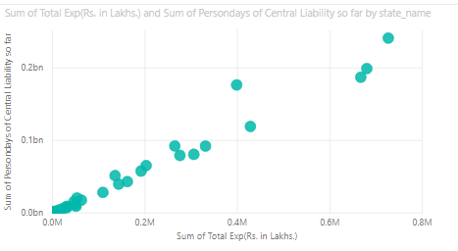
3.What is the utilization of the allocated budget, and how does it correlate with employment generation?
The total expenditure is somewhat similar in all the states including the ones allocated very high budgets compared to other states
Budget is highly under-utilized in various states.
Considering the direct relation with higher person-days and higher expenditure, more employment could have been generated if certain states utilized the budget efficiently.

Slide 8
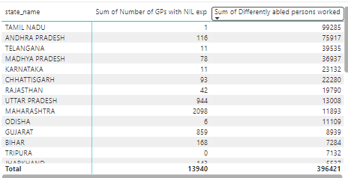
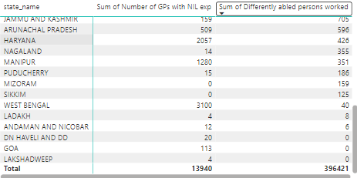
What are the key factors contributing to the completion of NREGA works, and are there any roadblocks to its success?
Road Blocks:
Total number of Gram Panchayats with NIL
expenditure is 13940, which means there
might be implementation challenge or some
other challenge such as local engagement.
Sum of differently abled persons worked are lower
in certain states which might indicate lack of jobs
that suits them.

Slide 9
Can data-driven insights guide policymakers and administrators in optimizing the scheme's impact?
Data-driven insights can significantly guide policymakers and administrators in optimizing NREGA's impact.
By analyzing trends and identifying regions with low active job card rates, resources can be targeted more effectively to address implementation challenges.
Insights into budget utilization and employment generation help ensure funds are allocated efficiently and reach the intended beneficiaries.
Additionally, tracking inclusivity metrics, such as the participation of differently-abled persons, ensures the scheme is equitable and accessible to all eligible households.

Slide 10
Thank You

